Slide 1

Marketing Campaign Analytics report

Slide 2

Agenda
Executive Summary
Methodology
Results
Findings
Conclusion

Slide 3

Executive summary
In this data analysis project, I have conducted a comprehensive analysis on marketing campaign dataset containing 200000 records and 16 columns. The project involved rigorous data cleaning for generating a quality data and extensive exploratory data analysis of the dataset for in-depth hidden insights. Leveraged Power BI for visualization, my analysis revealed various critical insights into key performance indicators, trending campaign, campaign performance over time, engagement score analysis, financial metrics, top channels with most conversion rate, favourable combination of types of campaigns and channels used, empowering advertising companies for strategic decision making in marketing domain.

Slide 4




Methodology
KAGGLE
PYTHON
POWER BI
GITHUB
Data Collection
Kaggle is a vast resource offering a wide variety of datasets, enabling seamless data collection
Data Handling
Pandas, NumPy, and Matplotlib enable efficient data cleaning, manipulation, and analysis for key insights
Data Visualization
Power BI is my preferred tool for visualization, offering interactive dashboards that effectively communicate key insights from marketing data
Project Sharing & Collaboration
GitHub offers a centralized platform for version control and collaboration, also serving as a repository for project sharing
This Photo by Unknown Author is licensed under CC BY-SA
This Photo by Unknown Author is licensed under CC BY-SA
This Photo by Unknown Author is licensed under CC BY-NC-ND

Slide 5

Results

Slide 6

Key performance indicators
Metric | Current Status
Revenue | $15,020,000,000
Acquisition Cost | $ 3,000,000,000
Net Profit | $ 1,200,000,000
Average Conversion Rate | 8.01 %
ROI | $ 5.00
Acquired Customers | 9,000,000
Impressions | 1,000,000,000
Clicks | 110,000,000
CTR | 11 %
Campaign Count | 5

Slide 7
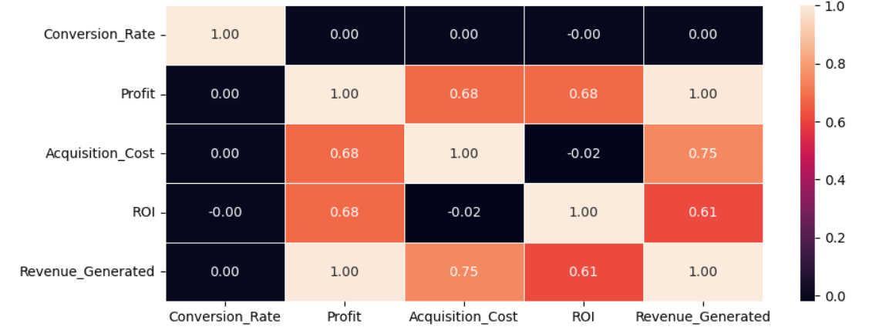
Financial metrics
RESULTS
Acquisition cost and revenue is showing strong correlation by 0.75, indicates as acquisition cost is increasing, revenue increasing.
Acquisition cost and profit is also having moderately strong correlation of 0.68, indicates as acquisition cost increasing, profit increasing.

Slide 8
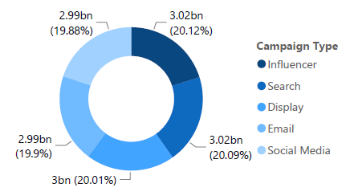
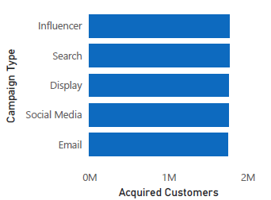
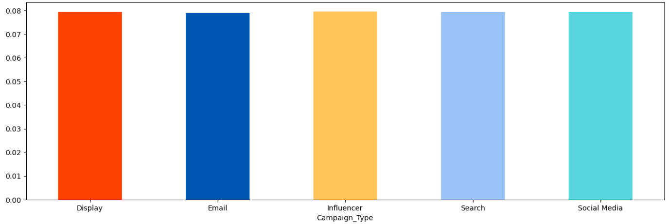
The most trending campaign
RESULTS
The result from the analysis show that Influencer type campaigns are on trends overall from various aspects like revenue generated, acquired customers and conversion rate

Slide 9
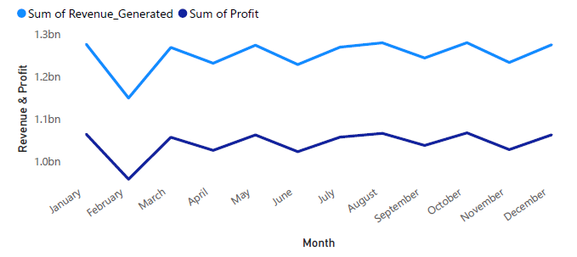
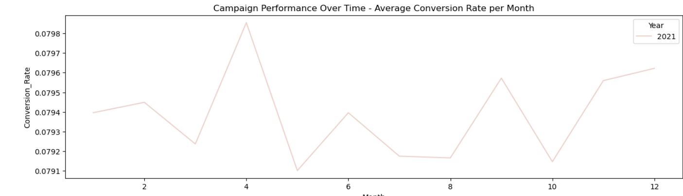
Campaign Performance Over Time
RESULTS
Total Revenue & Profit Generated per Month
Total Revenue Generated per Month
High Significant drop in April; recovery begins in March.
Highest revenue generated in August.
Average Conversion Rate per Month
Fluctuating conversion rates with no clear trend.
Peak in April; lowest in May.
Month-to-month variations without clear seasonal patterns.
Average Conversion Rate Per Month

Slide 10
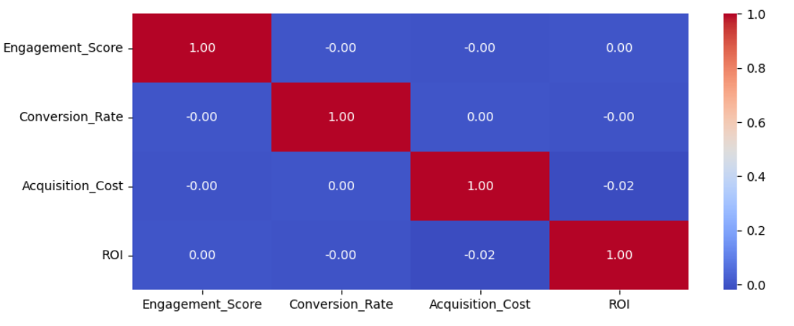
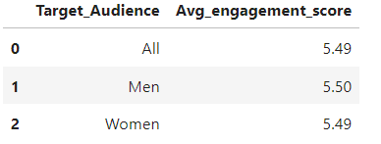
Engagement score analysis
RESULTS
Engagement Score
Vs
Financial
Metrics
Engagement score does not have any impact on financial factors as well as even not on target audience. This indicates that high engagement score does not means increase or decrease in conversion rate. Users just engaging with the campaigns by liking, commenting and sharing does not mean that they will buy or do the signup.
Average
Engagement Score
Vs
Target Audience

Slide 11
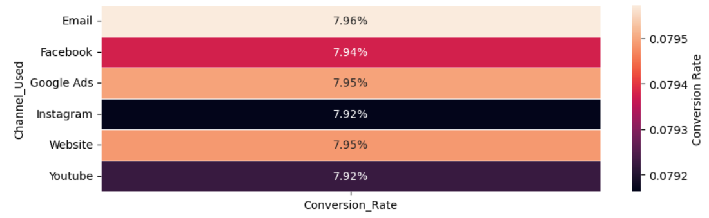
Top channels with most conversion rate
RESULTS
Email is having highest conversion rate of 7.96%, followed by Google Ads and Website both are having 7.95%.

Slide 12
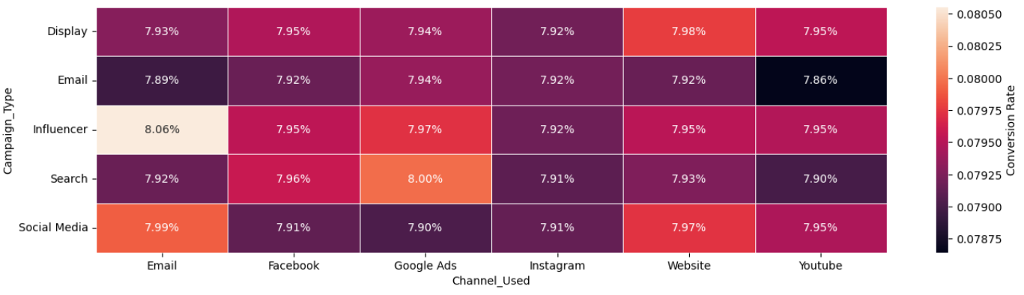
favourable combination of types of campaigns and channels
RESULTS
Influencer campaign on Email is having higher conversion rates by 8.06% and Search campaign on Google Ads is having second highest conversion rates by 8%

Slide 13


MARKET EXPANSION
Unlocking new horizons

Slide 14


MARKETING STRATEGIES
Implement personalized engagement strategies
Tailor campaigns to resonate with specific demographics, fostering a sense of relevance and connection
Collaborate with influencers and thought leaders to amplify our brand message

Slide 15


INNOVATIVE SOLUTIONS

Slide 16
FUTURE INITIATIVES
Product enhancement. Introduce regular updates and features to enhance product offerings.
Technology integration. Explore emerging technologies for potential integration into our operations.
Collaborative partnerships. Foster collaborations with tech innovators and industry leaders to drive innovation.
Green supply chain
Reduced carbon footprint
Waste reduction
Water conservation

Slide 17


Q&A
Please fill out our post-meeting survey

